Slide 1
Module 06
VSC-HVDC components

Slide 2
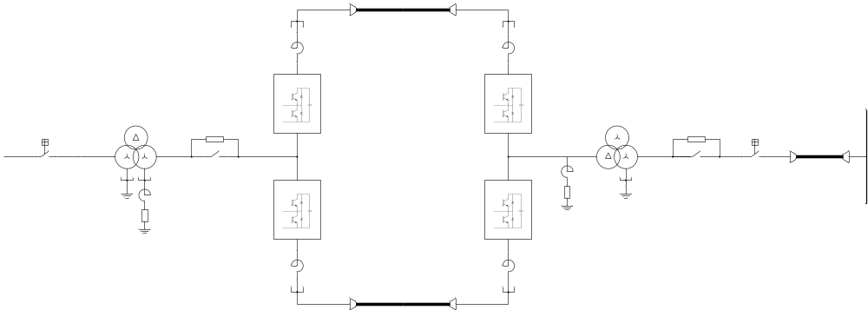
Main components
  AC circuit breaker
  Transformer
  Pre-Insertion Resistor (PIR)
  Star Point Reactor (SPR)
  Reactor

Slide 3
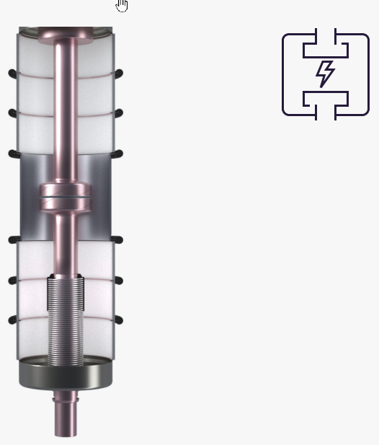
AC circuit breaker
Their main purpose is to clear any fault that might occur in the HVDC system
The circuit breaker operation principle:
      Rapidly separating two contacts surrounded by a liquid or gaseous insulating medium
      Arcing period till the next zero crossing of the current
      Arc is extinguished as quickly as possible
      After current interruption, transient recovery voltage(TRV) appears across the open contacts
High-Voltage Circuit Breakers From 72.5 kV up to 1100 kV
Siemens Energy

Slide 4
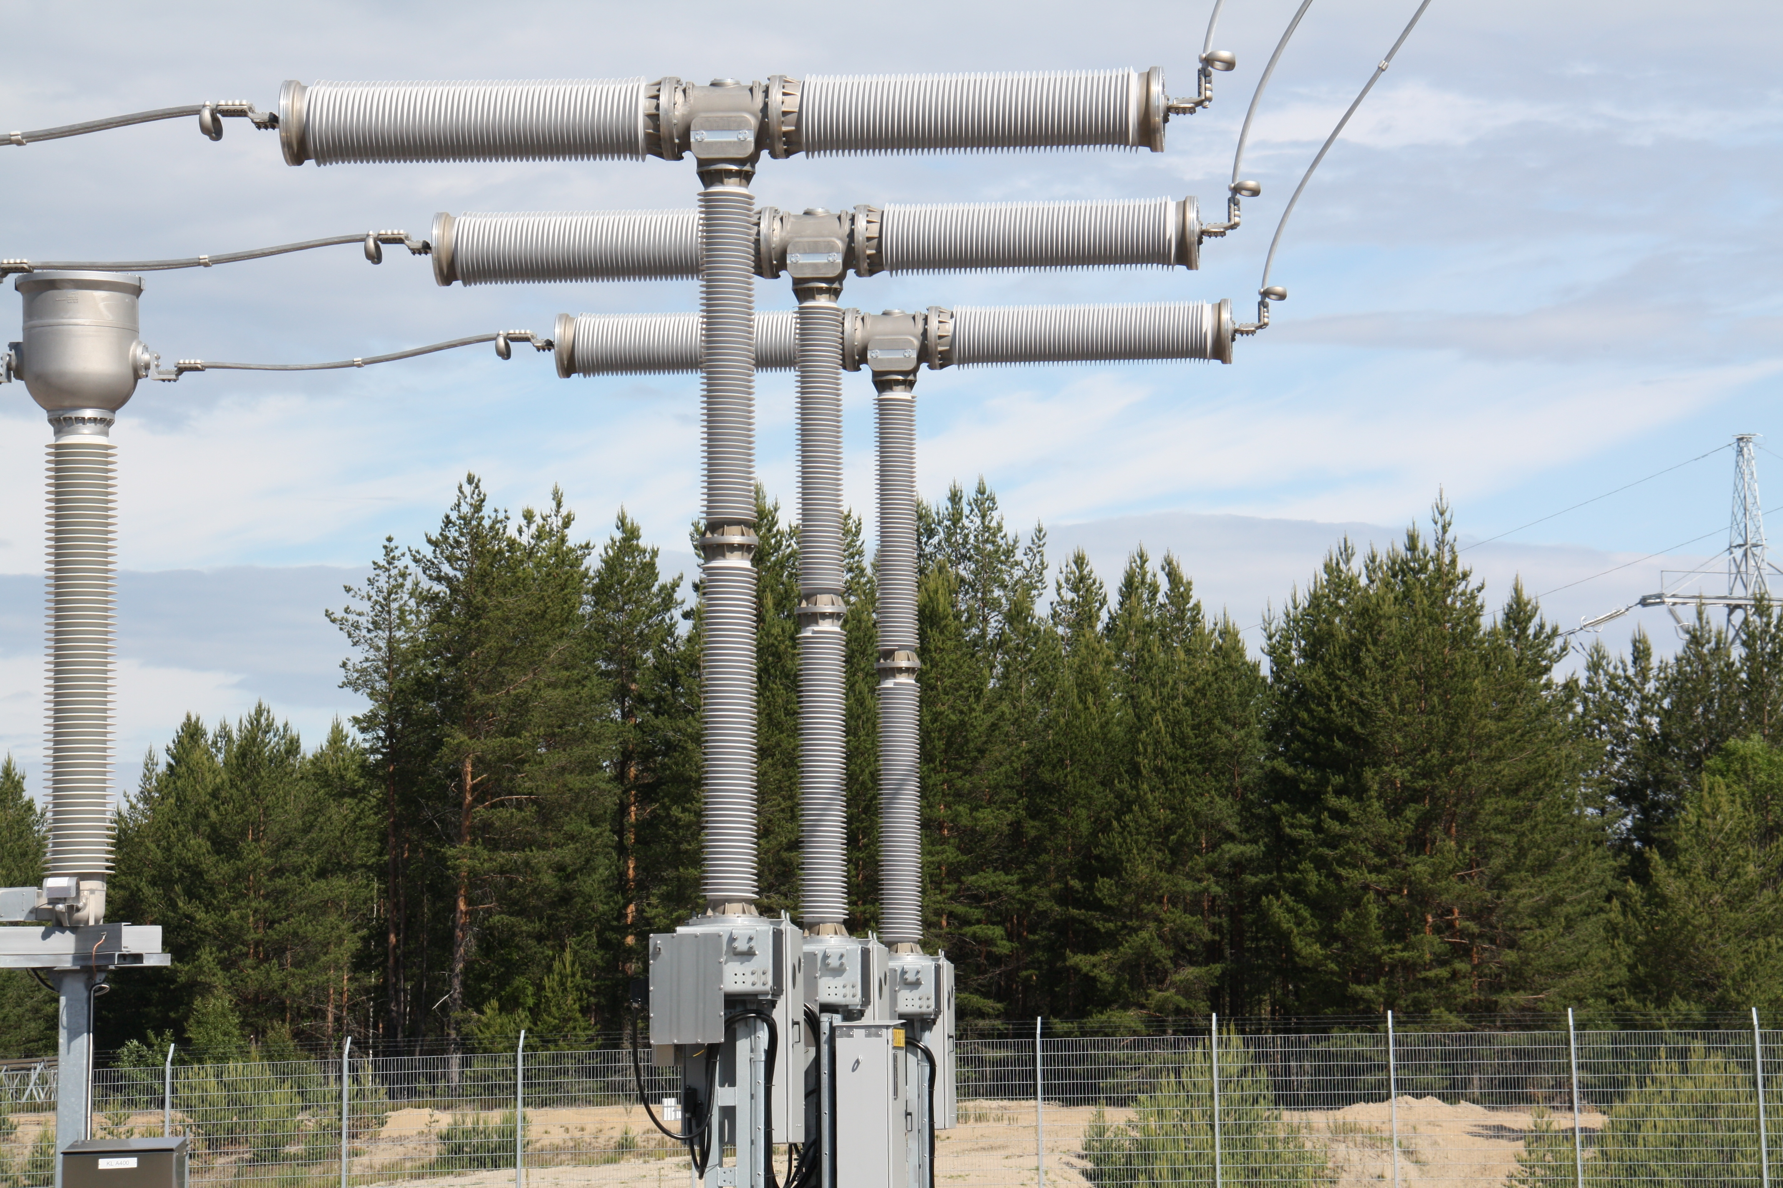
AC circuit breaker
Two type of mechanical set-ups are available
Live tank Circuit breaker
Dead tank Circuit breaker
https://www.siemens-energy.com/global/en/home/products-services/product-offerings/circuit-breakers.html#Vacuuminterruptionprinciple

Slide 5
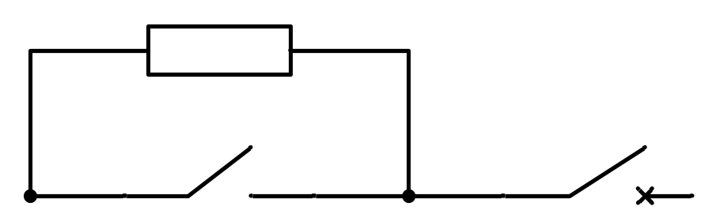
Pre-Insertion resistor (PIR)
Connecting capacitors to the AC grid would cause a high charging current into the converter limited only by the transformer and converter impedance
The high current would cause high stress to the AC grid and the converter equipment
PIR limits the current during the energization phase and is bypassed after the energization process has been finished

Slide 6
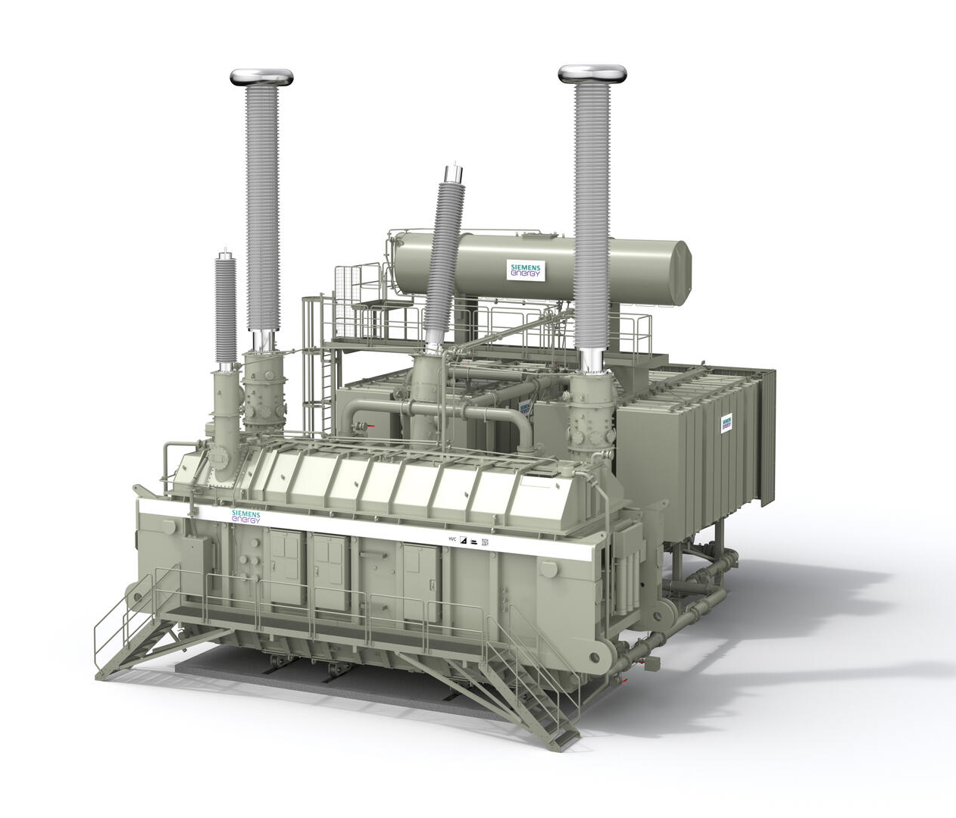
Converter transformer
Provides the connection between the AC system and the converter
The basic transformer function is the same as a normal AC power transformer: to transform AC voltage between the different voltage levels of the AC grid the voltage required by the converter
Following design concepts are considered:
  Vector groups
  1ph vs. 3ph
  2 winding vs. 3 winding
  On-Load Tap changer
https://www.siemens-energy.com/global/en/home/products-services/product/hvdc-transformers.html

Slide 7
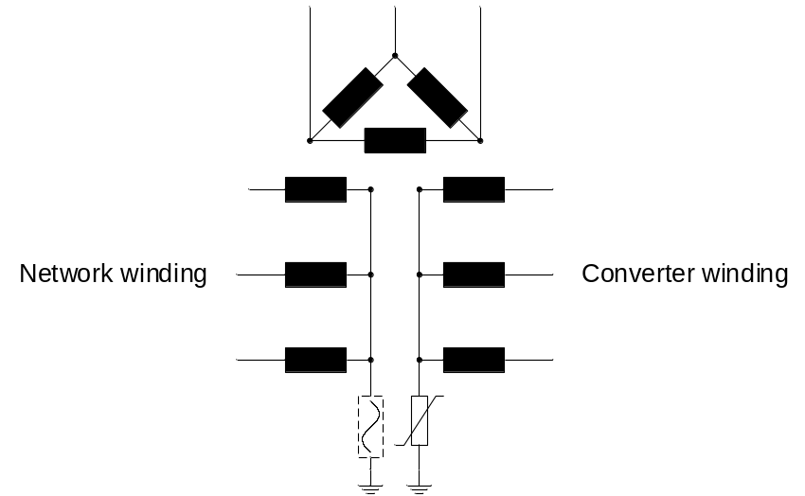
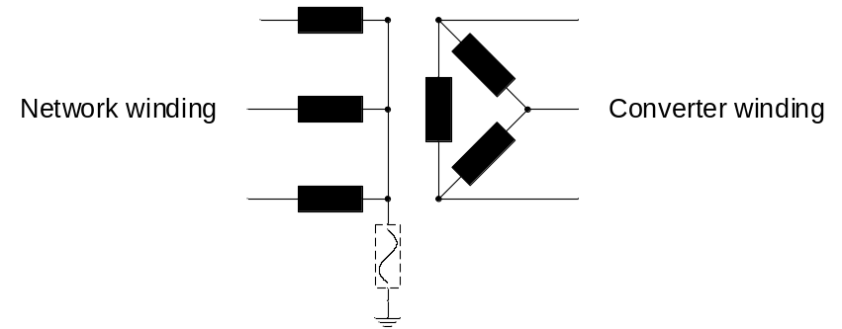
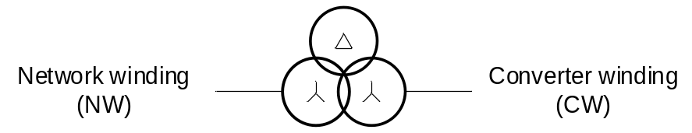

Converter transformer – Vector groups
Yd - Transformer
Yy - Transformer

Slide 8
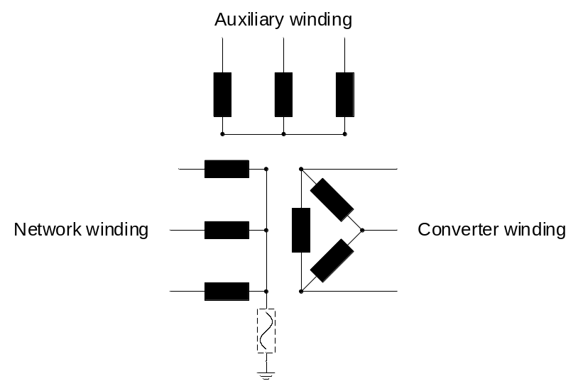
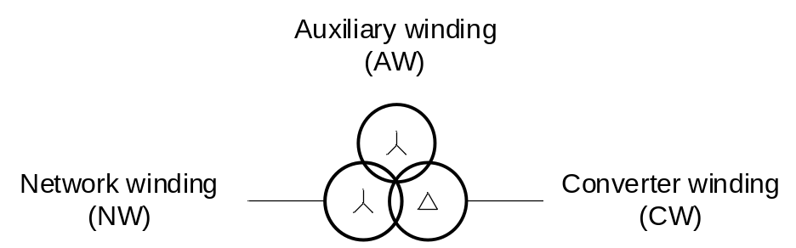
Converter transformer – 2 winding vs. 3 winding
Yd - Transformer
Yy - Transformer

Slide 9
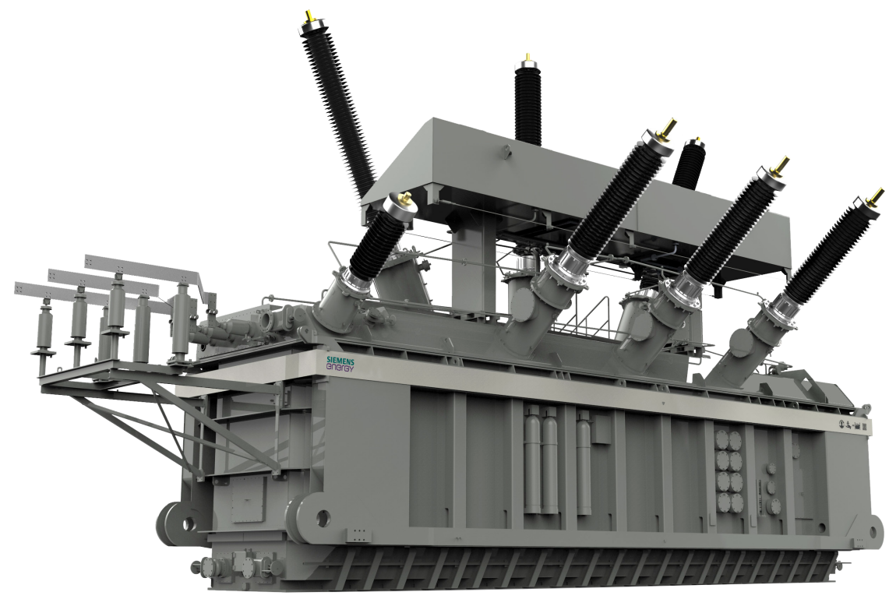
Converter transformer – 1ph vs. 3ph
1ph - Transformer
3ph - Transformer

Slide 10
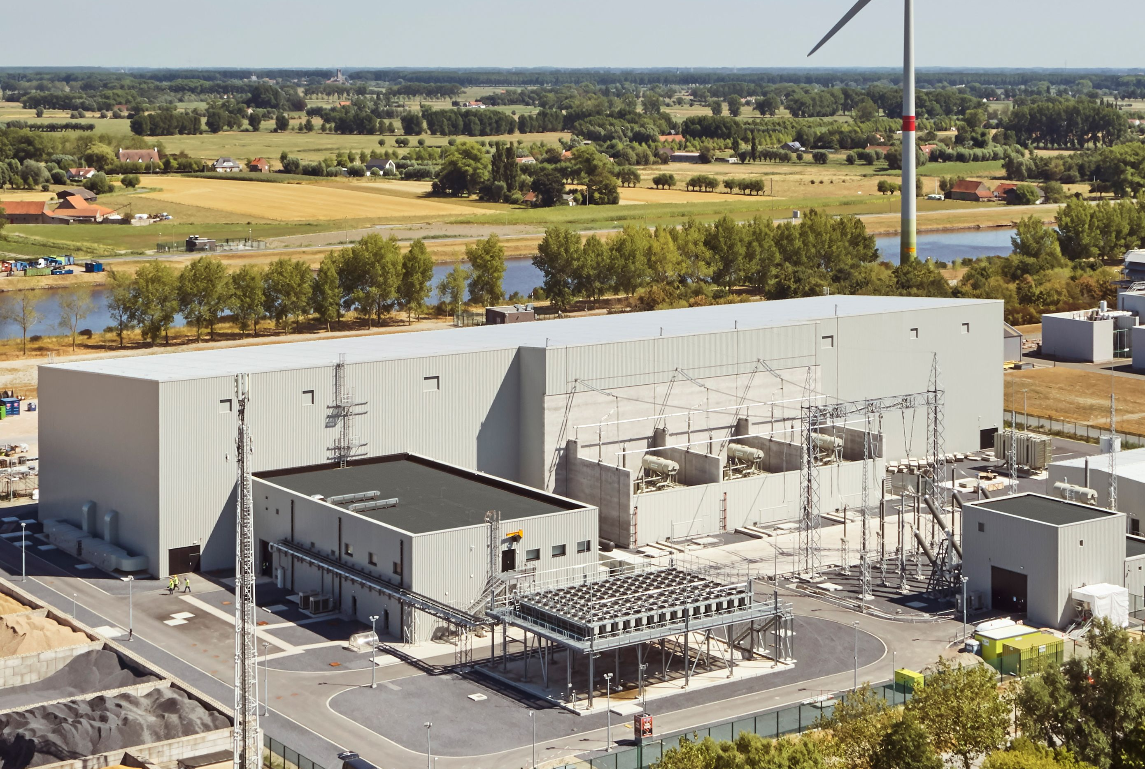
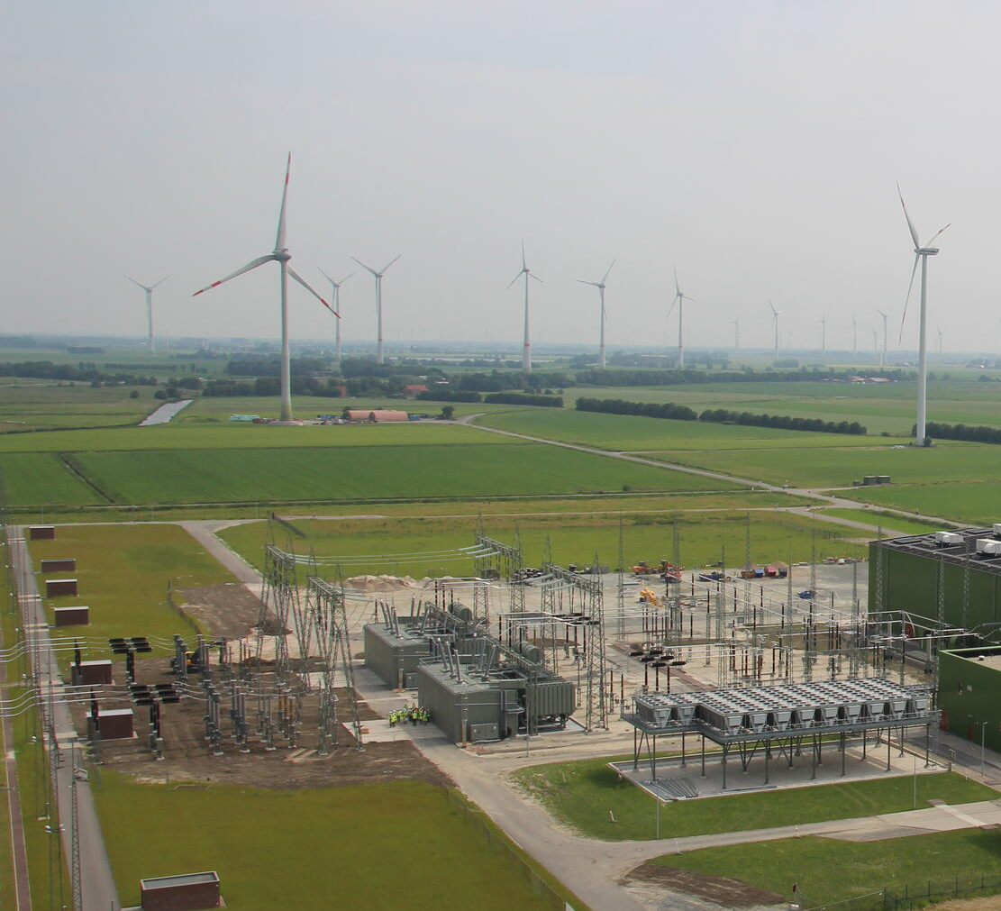
Converter transformer – 1ph vs. 3ph
1ph - Transformer
3ph - Transformer

Slide 11


Converter transformer – Transportation

Slide 12
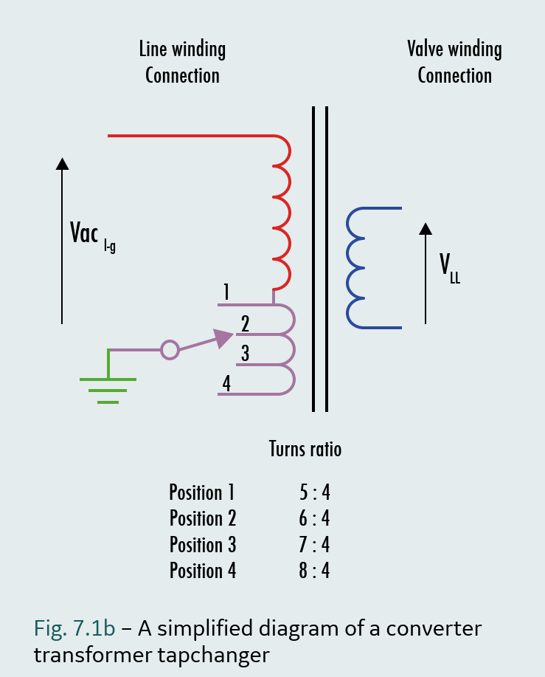
On-Load Tap Changer (OLTC)
Mechanical switching device that changes the turns-ratio of the transformer in voltage steps
A tapchanger step adds or subtracts 1 - 1.25% to the converter transformer turns ratio
The maximum number of steps of a tapchanger is usually around 32, giving a maximum achievable voltage change of around 40%
Tapchanger is a mechanical device with limited operation speed and can not be used for dynamic control
Transmission Systems: Line Commutated Converters. © GE Vernova, 2023

Slide 13
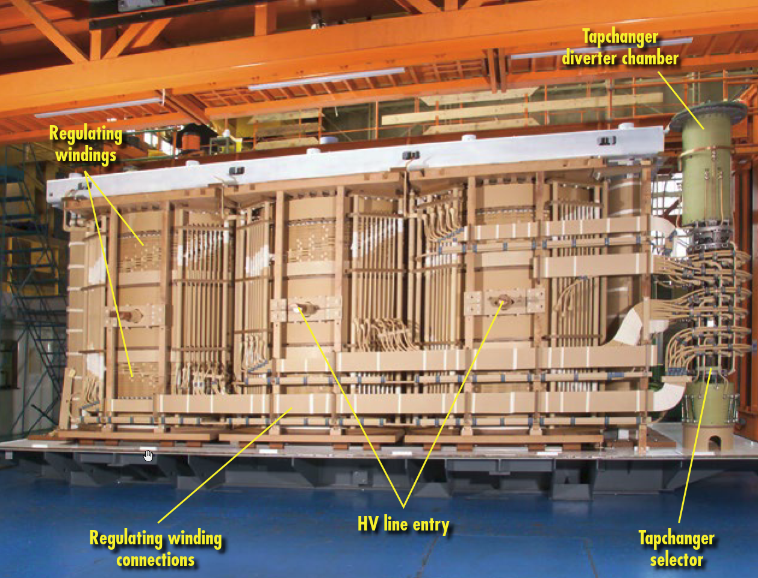
On-Load Tap Changer (OLTC)
Fig. 6.4.3e – Line side cleat bar for 3-phase, 2-winding transformer, star connection Transmission Systems: Line Commutated Converters. © GE Vernova, 2023

Slide 14
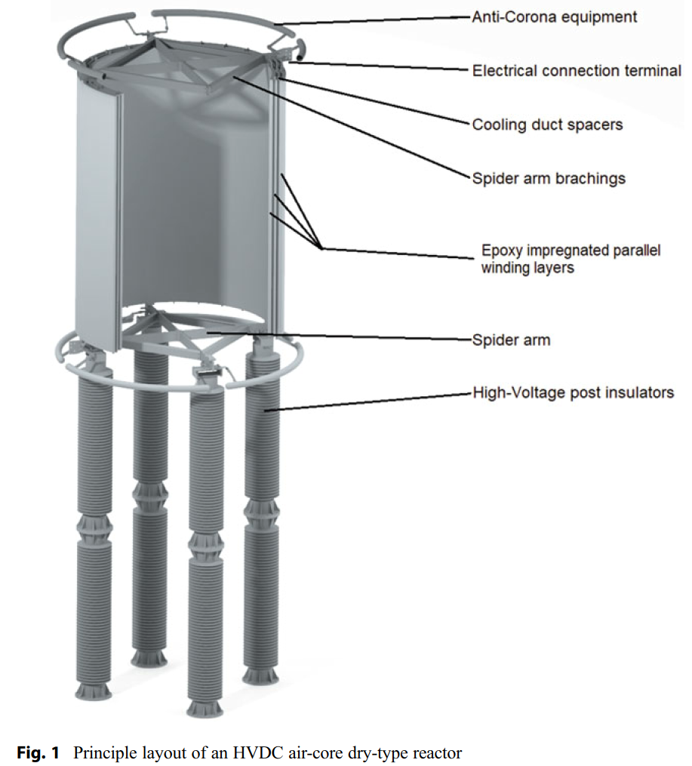
Converter reactor
Decoupling of phases and limitation of short circuit currents
Air-Core Dry-Type Reactors
  Do not utilize an oil insulation system
  Do not need auxiliary equipment
  Normally cooled by natural air ﬂow (convection and radiation cooling)
  The insulation to ground is provided by porcelain or composite post insulators
CIGRE. High Voltage DC Transmission Systems
Reactors for LCC and VSC HVDC Converter Stations

Slide 15
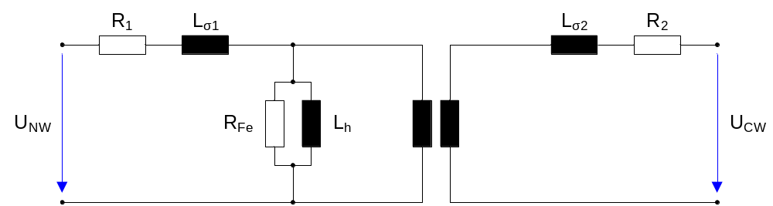
Transformer load flow calculation
The power rating for network winding (NW) and converter winding (CW) rating are similar for the VSC-HVDC transformers
Main inductance is very high and can be neglected for load flow calculations

Slide 16
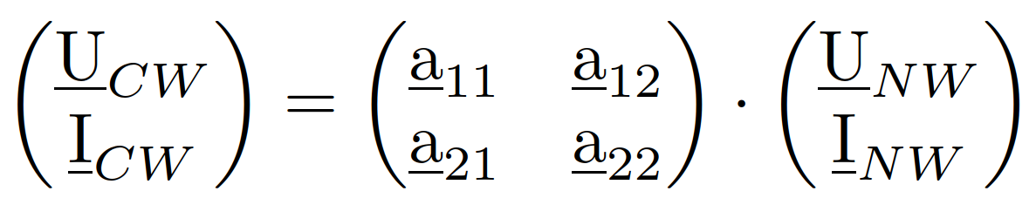
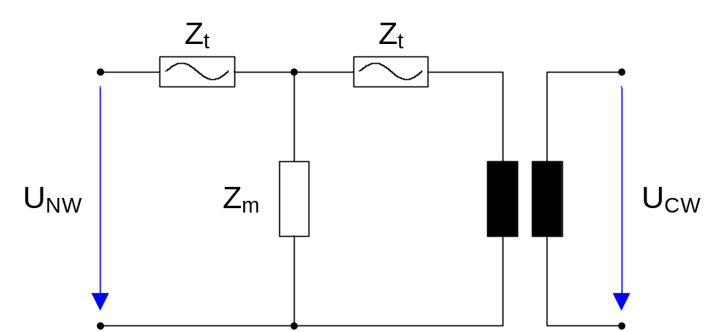
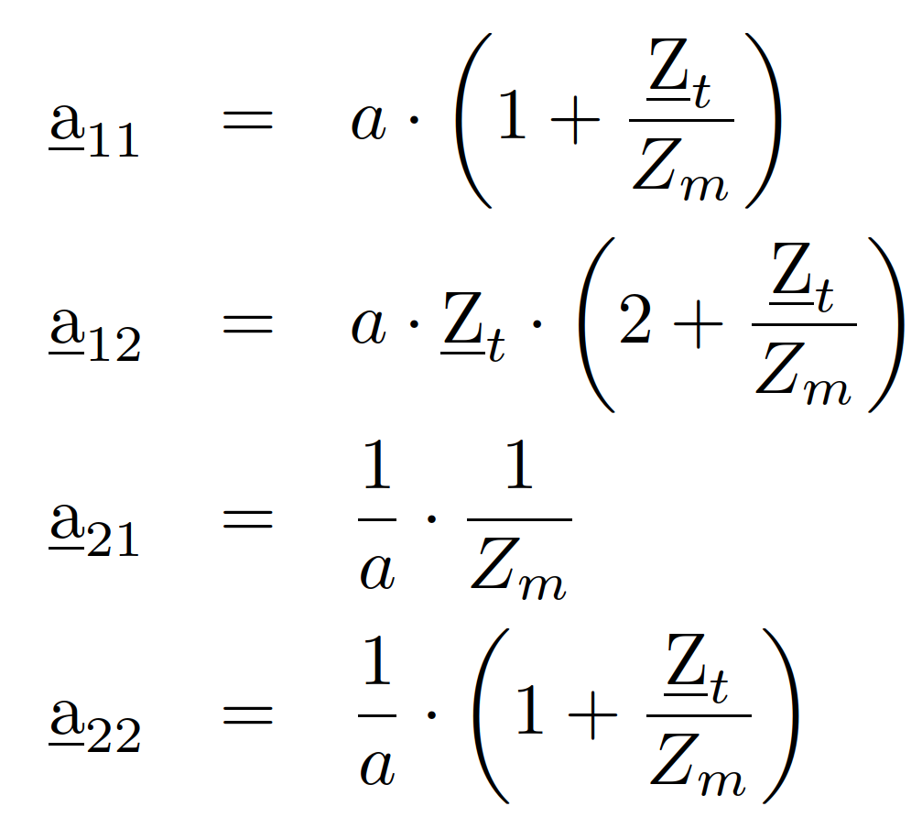
Transformer load flow calculation
For load flow calculations the transformers can be represented with T-model
Calculation is based on the Two-port representation of the transformer

Slide 17
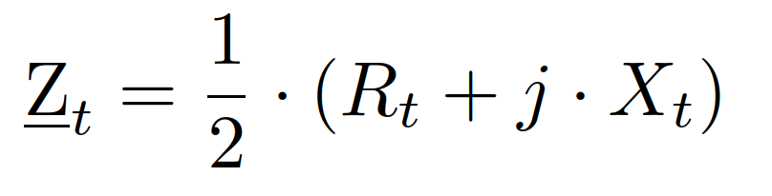
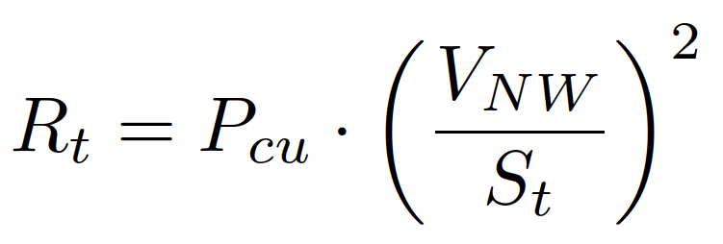
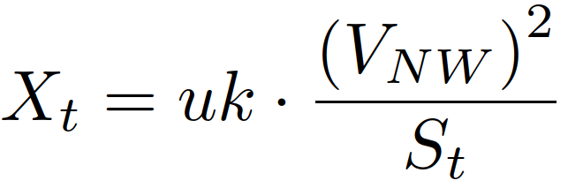
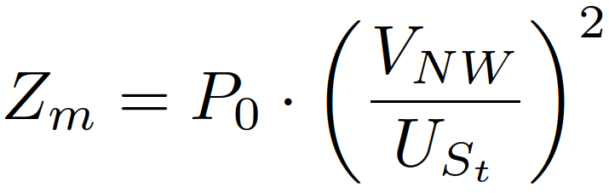
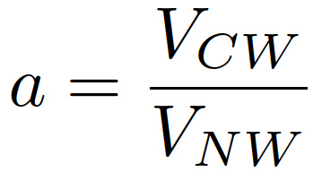
Transformer load flow calculation
The transformer is defined by following parameters
f Frequency
S_{T} Transformer rating
V_{NW} Primary winding voltage
V_{CW} Primary winding voltage
P₀ No load losses
P_{Cu} Copper losses
u_{k} Positive sequence leakage reactance

Slide 18
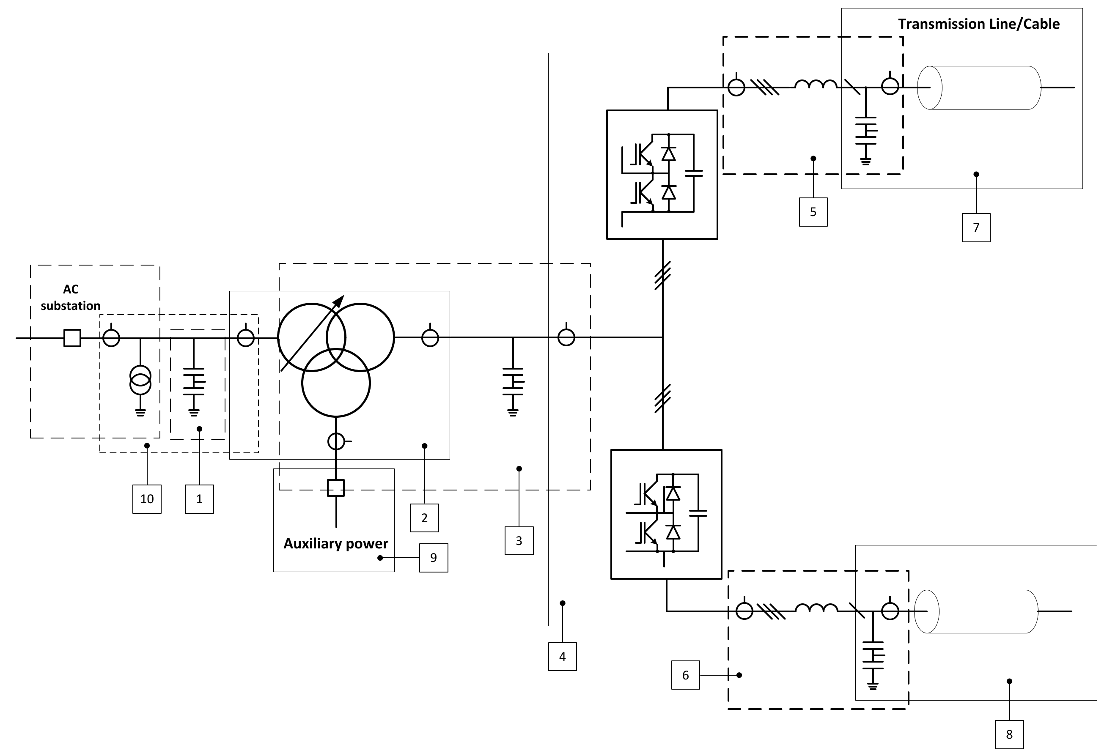
Measuring Scheme
Current measurement
Voltage measurement
CIGRÉ 832: Guide for Electromagnetic Transient Studies Involving VSC Converters

Slide 19
Measuring Transducers
Measure the analog signals voltage and current signals required for monitoring and control of the HVDC system
These measurement devices are located in the HV plant itself and usually convert the measured signal to a level and form suitable for subsequent processing (< 5A, <10V)
Any major scaling of the measured signal is usually implemented on the
  measurement device itself
  additional associated equipment
The measurement transducers of electrical (galvanic) isolation between the raw HV signals and the electrically clean environment of the control cubicles

Slide 20
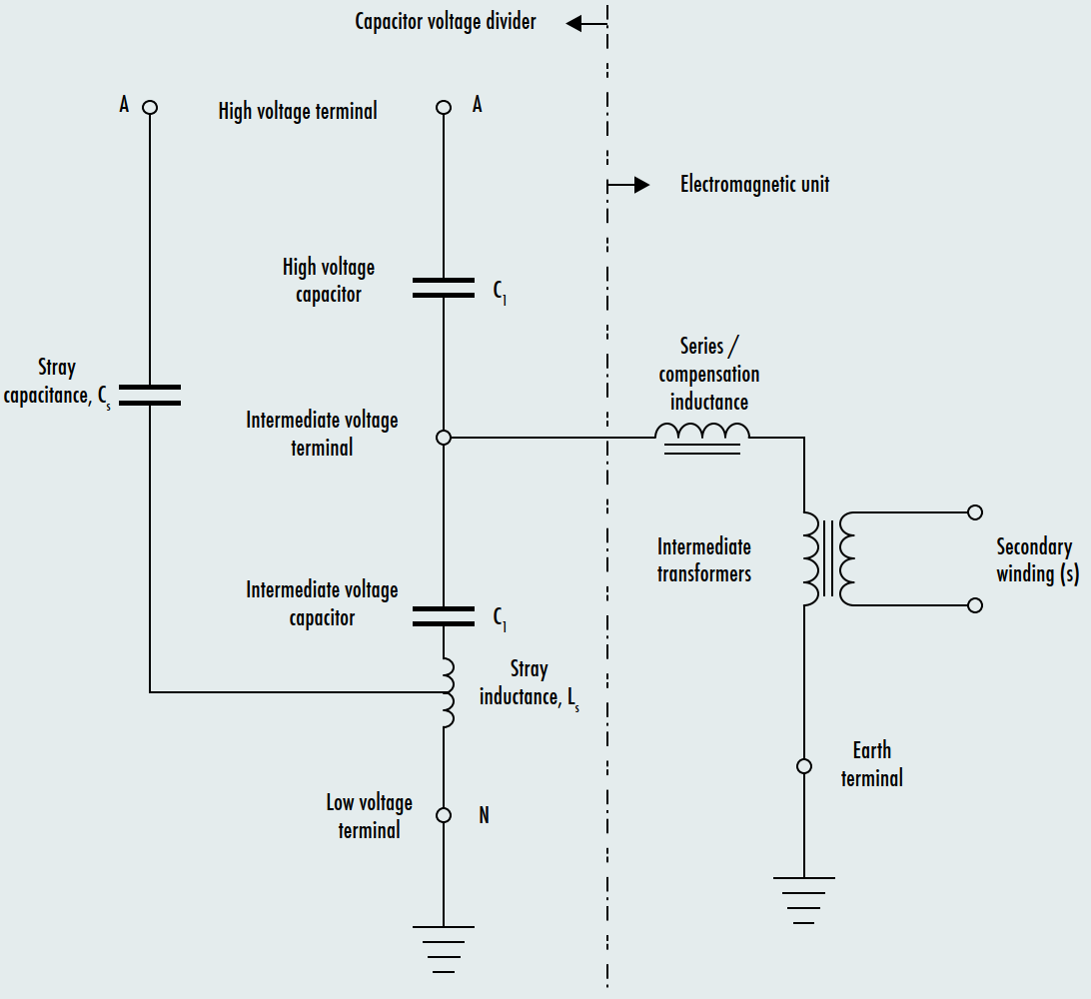
AC Voltage Measurement
AC voltage measurement can be done by:
Inductive Voltage Transformer
Capacitor Voltage Transformer (CVT)
Fig. 6.6.3a – Typical line diagram of a capacitor voltage transformer
DC Transmission Systems: Line Commutated Converters. © GE Vernova, 2023

Slide 21
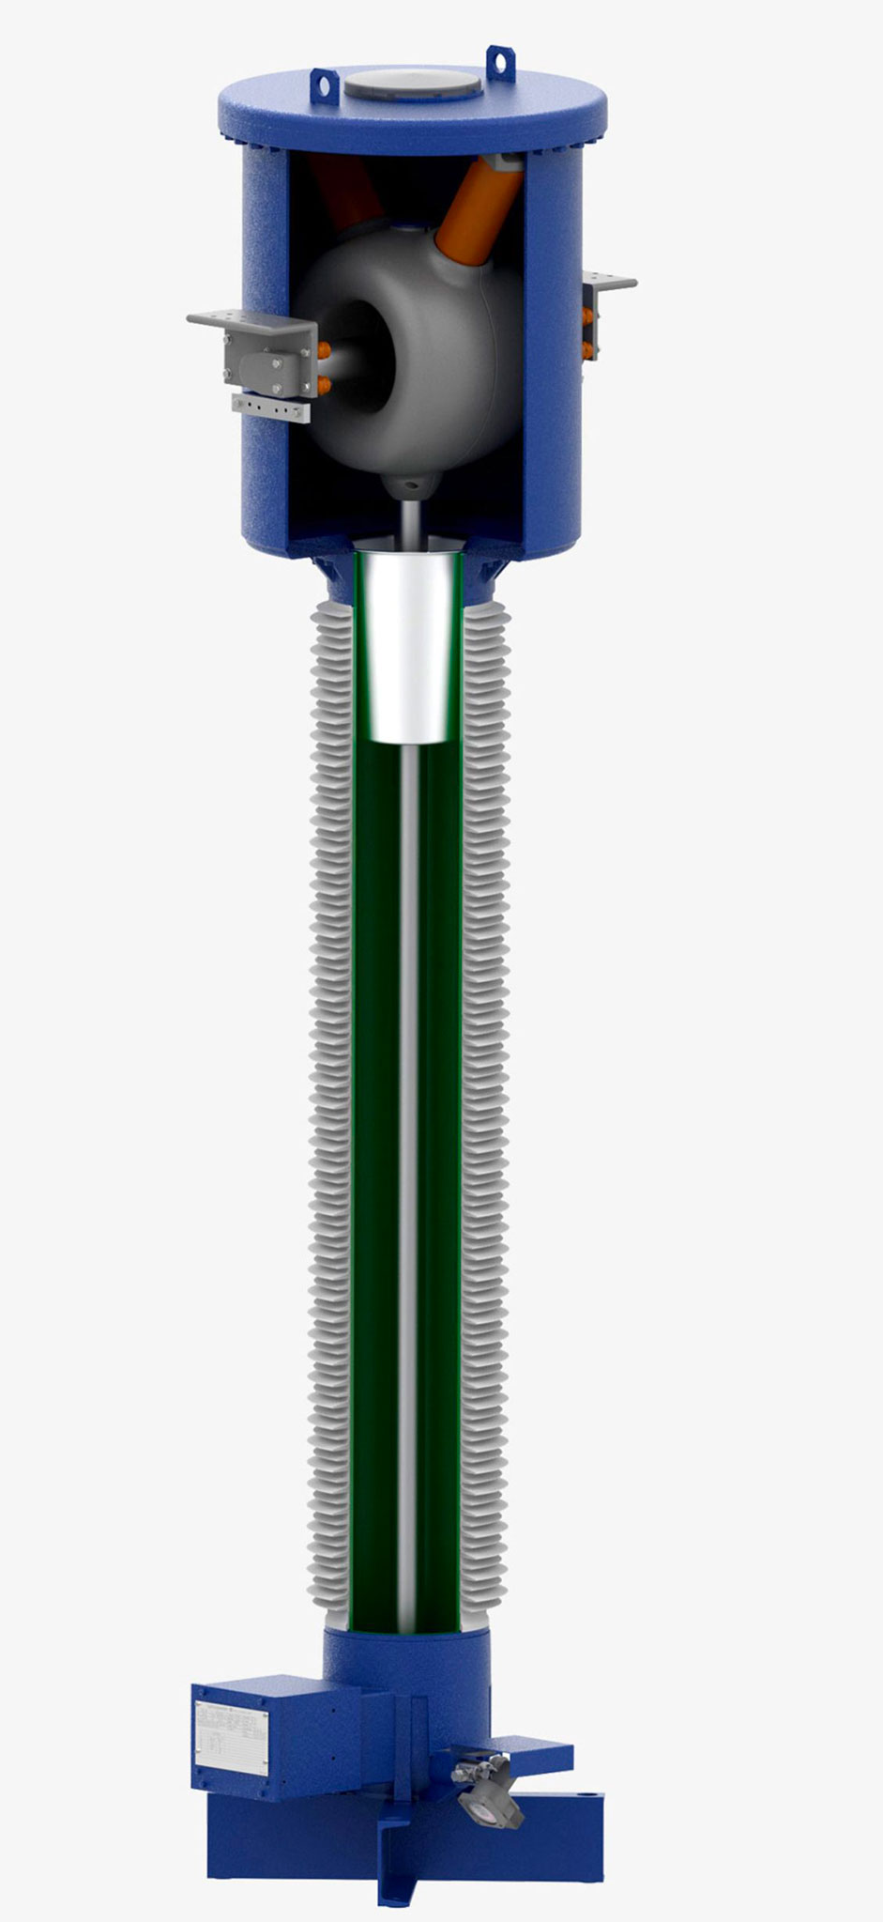
AC Current Measurement
AC current transformer
Measuring principle can be used for AC current measurements only
Different insulators can be used:
SF6
“Clean Air”
Lack the capability to measure currents at low frequencies (< 5Hz)
https://trench-group.com/wp-content/uploads/2024/01/Clean-Air-Current_preview.jpg

Slide 22
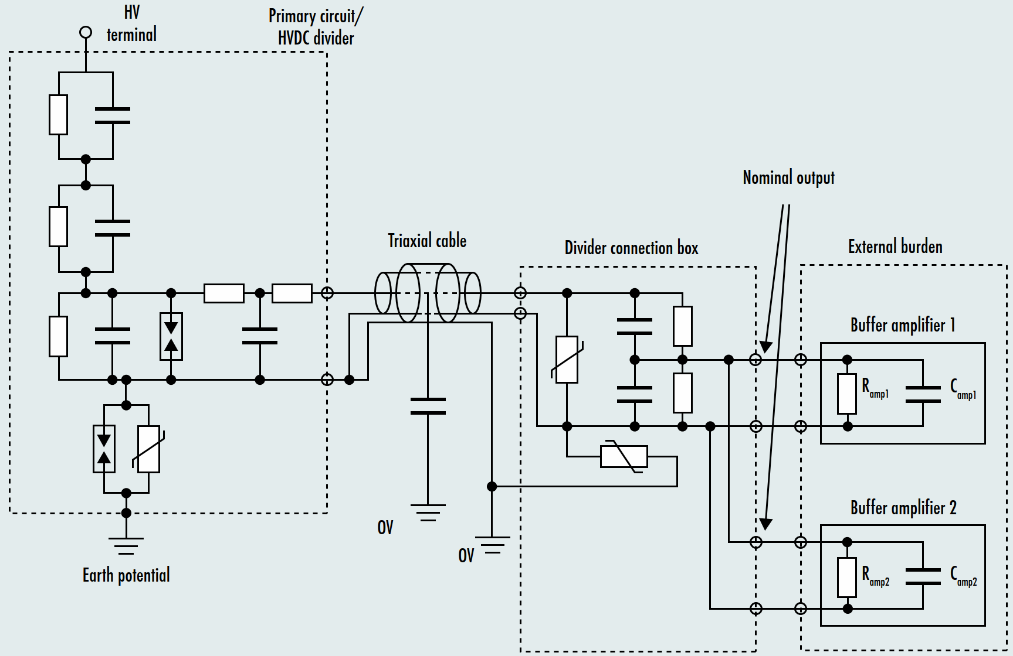
DC Voltage Measurement
Direct voltage on the HVDC busbar is measured by a DC resistive Voltage Divider (VD)
DC Transmission Systems: Line Commutated Converters. © GE Vernova, 2023

Slide 23
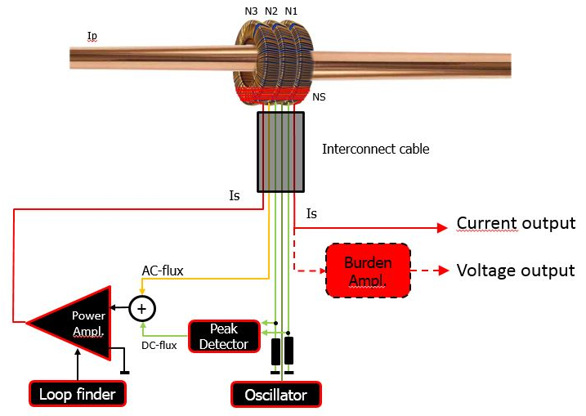
DC Current Measurement
DC Current Transducer (DCCT) used of DC current measurement
Zero Flux Current Transformers (ZFCTs)
Optical current transformers (OCT)
Measurement accuracies of 0.2% or better
Wide frequency range to allow especially very fast protection scheme
Installation of the ZFCTs has to be done over a bushing or cable
The Zero-flux Principle
https://www.pm-sms.com/?page_id=12

